Slide 1



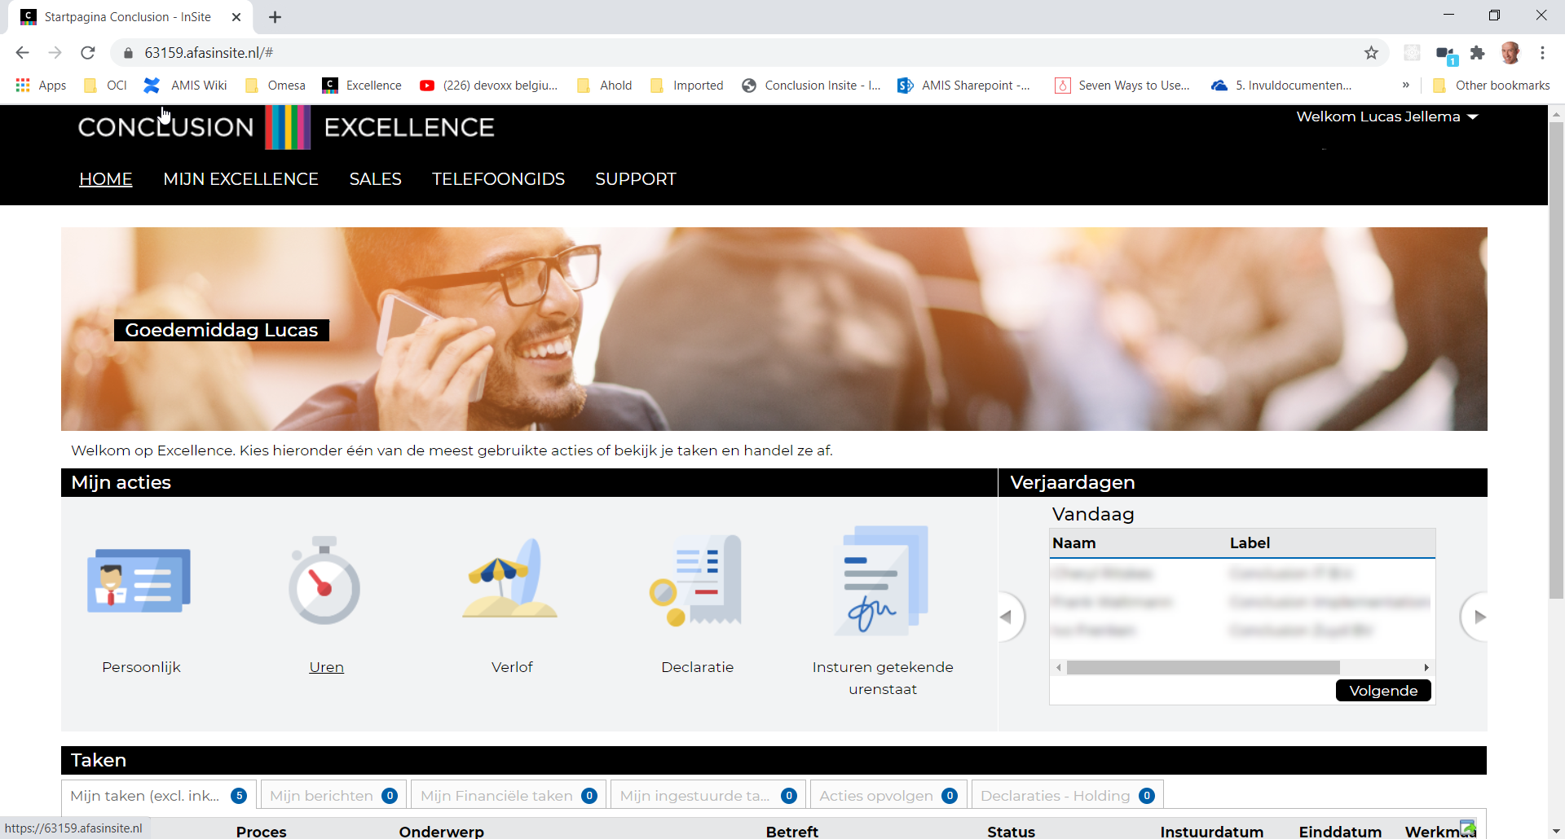



Playwright Automation of browser interaction
REAL Toolshed, December 2020
Lucas Jellema, CTO & Architect AMIS | Conclusion
sources: bit.ly/REAL-playwright

Slide 2

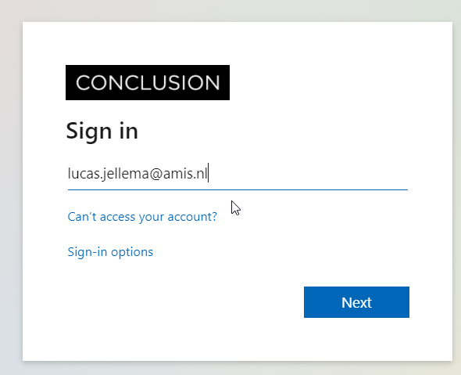
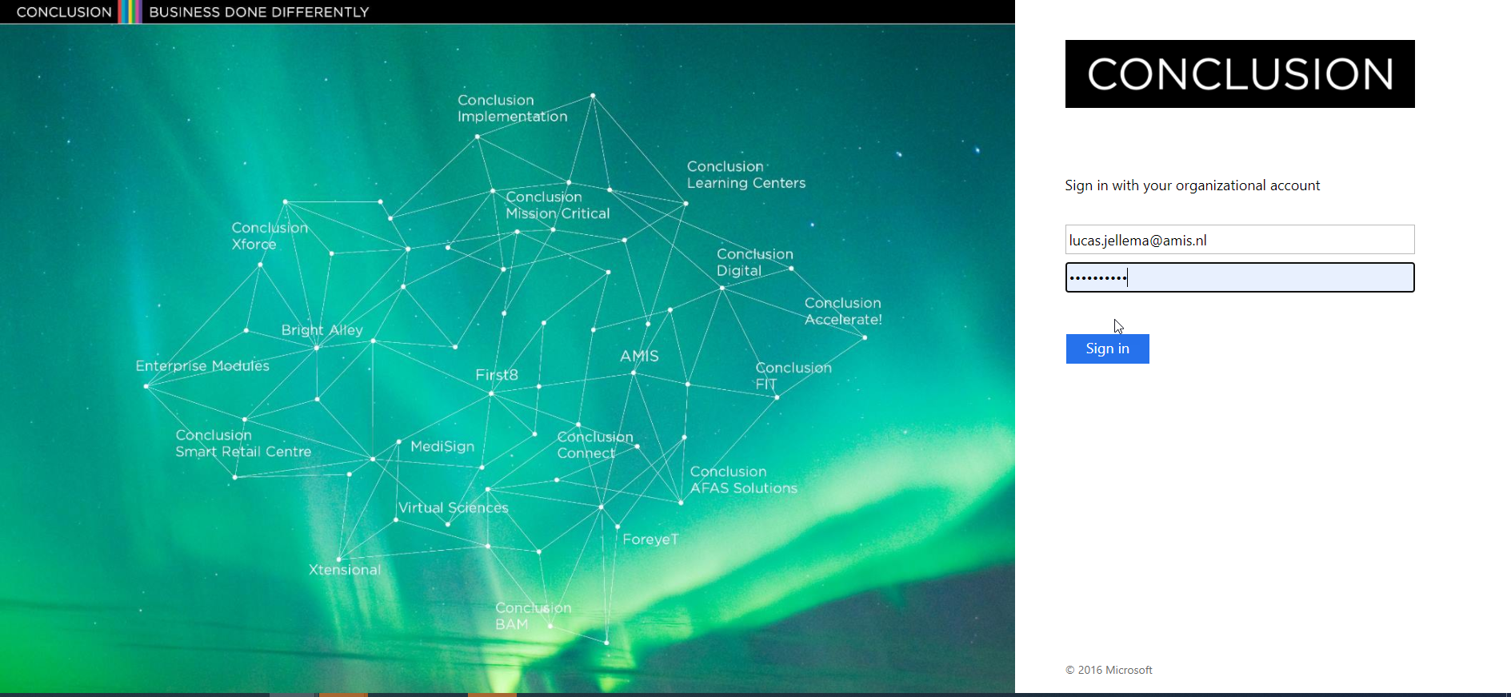
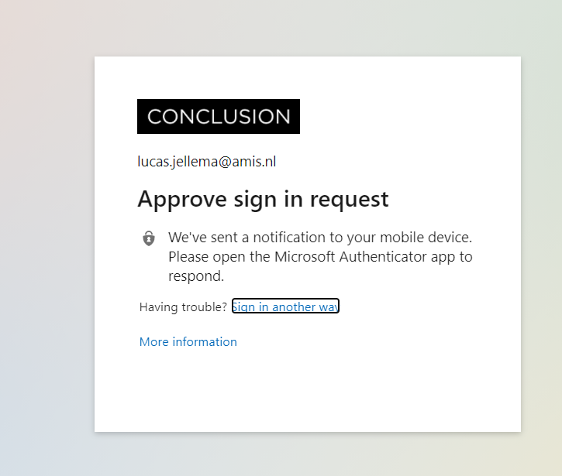
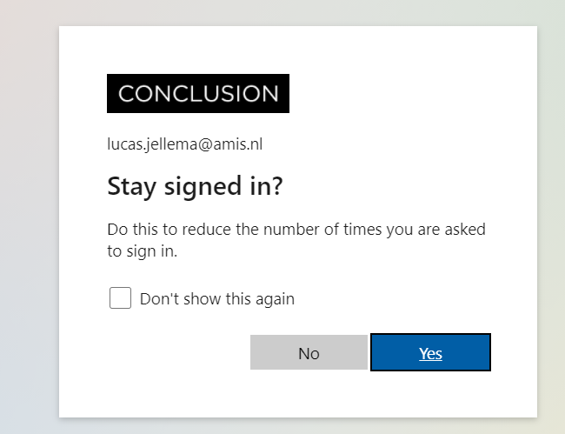
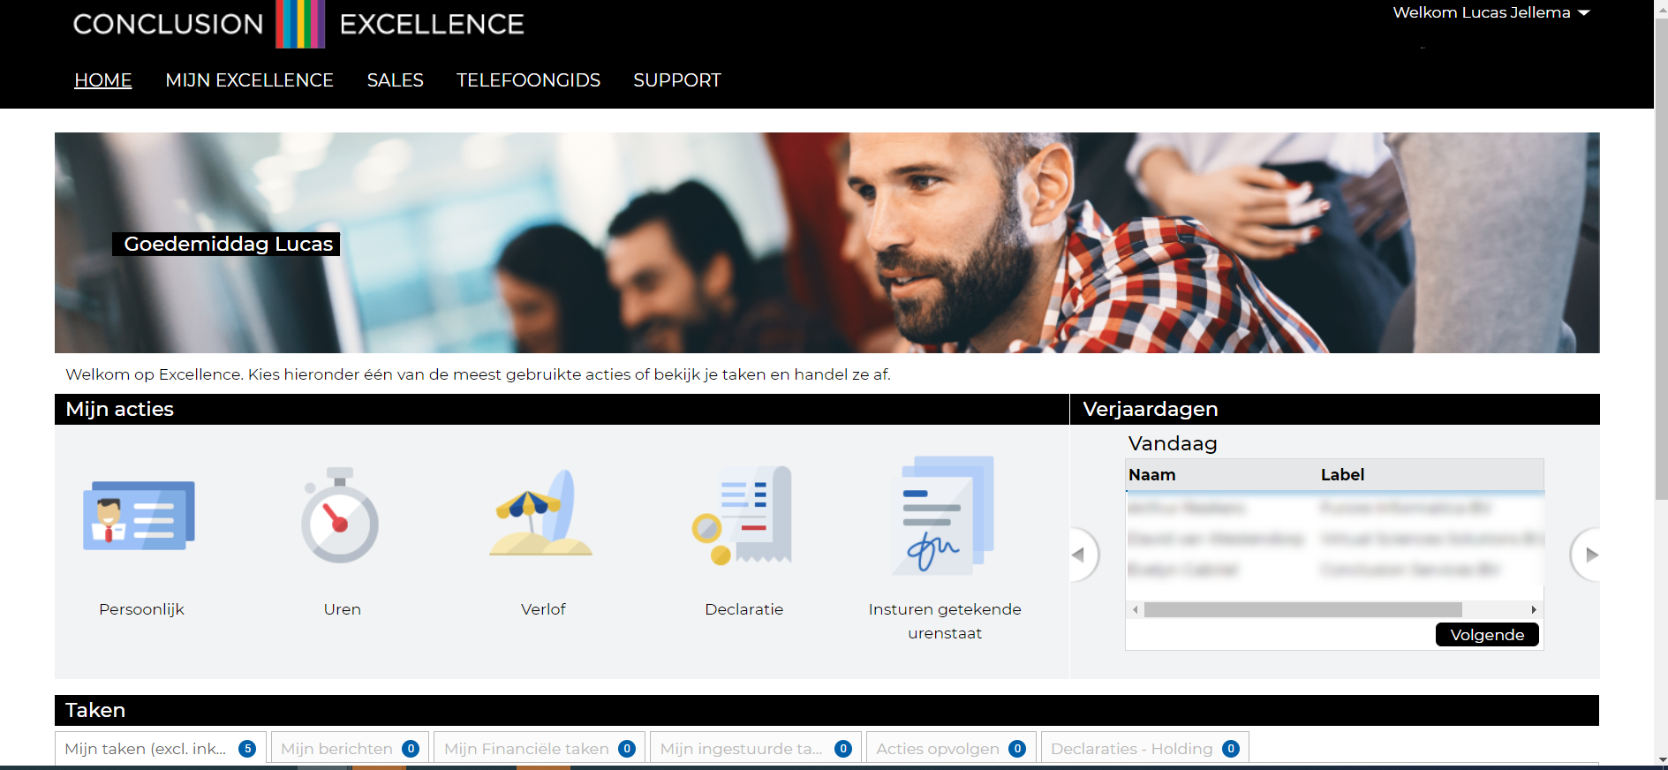
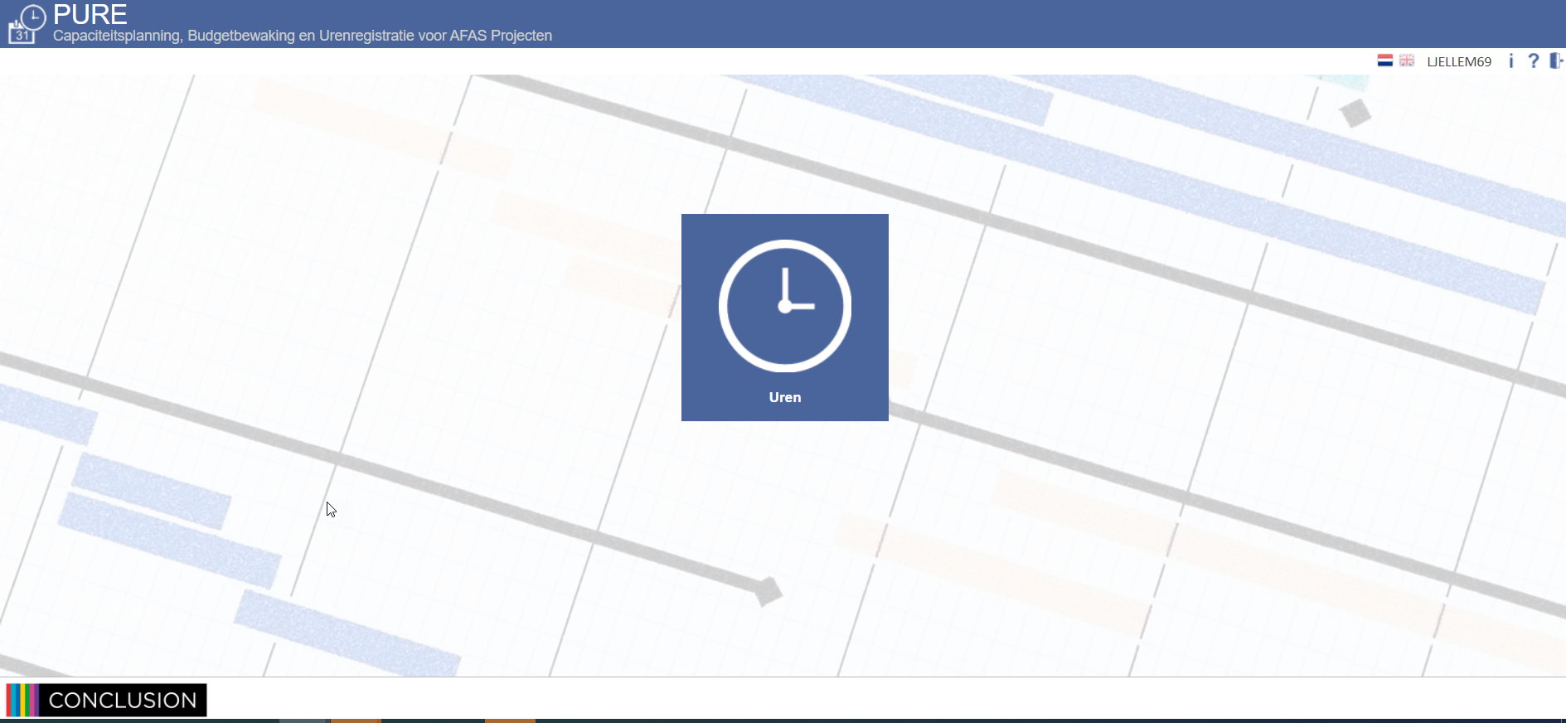
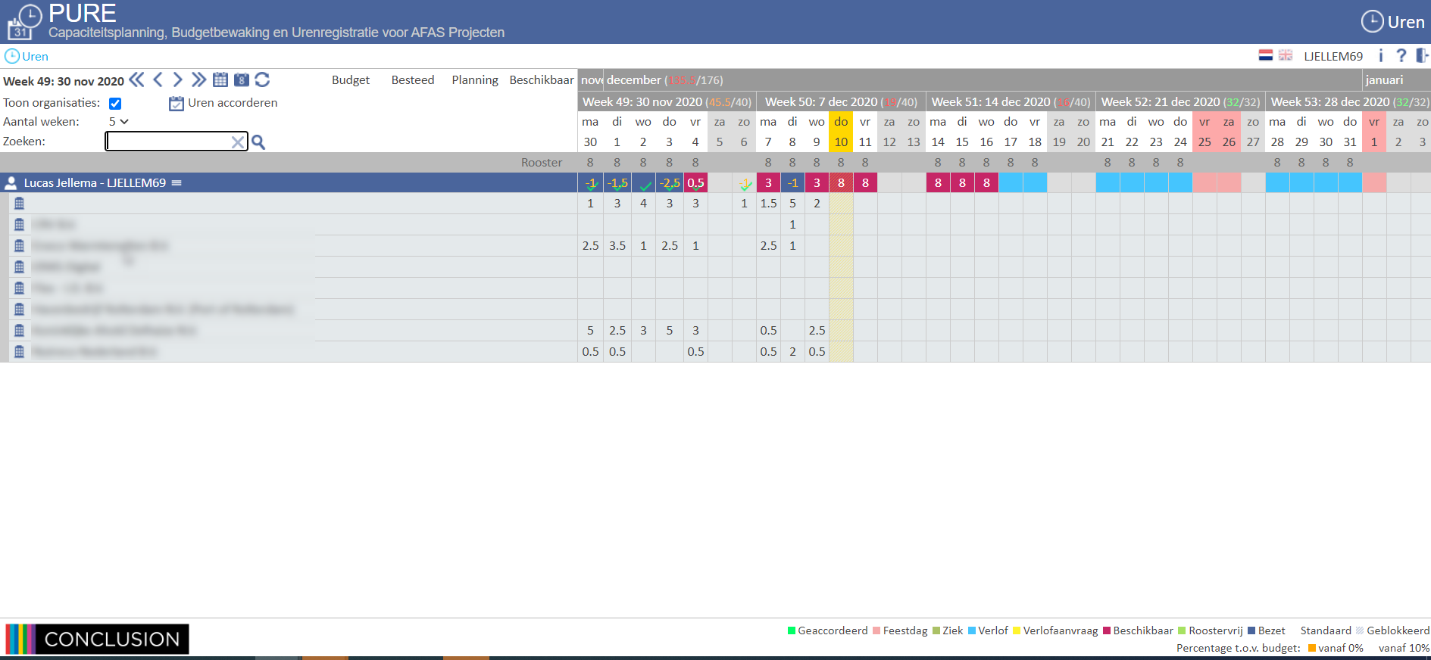
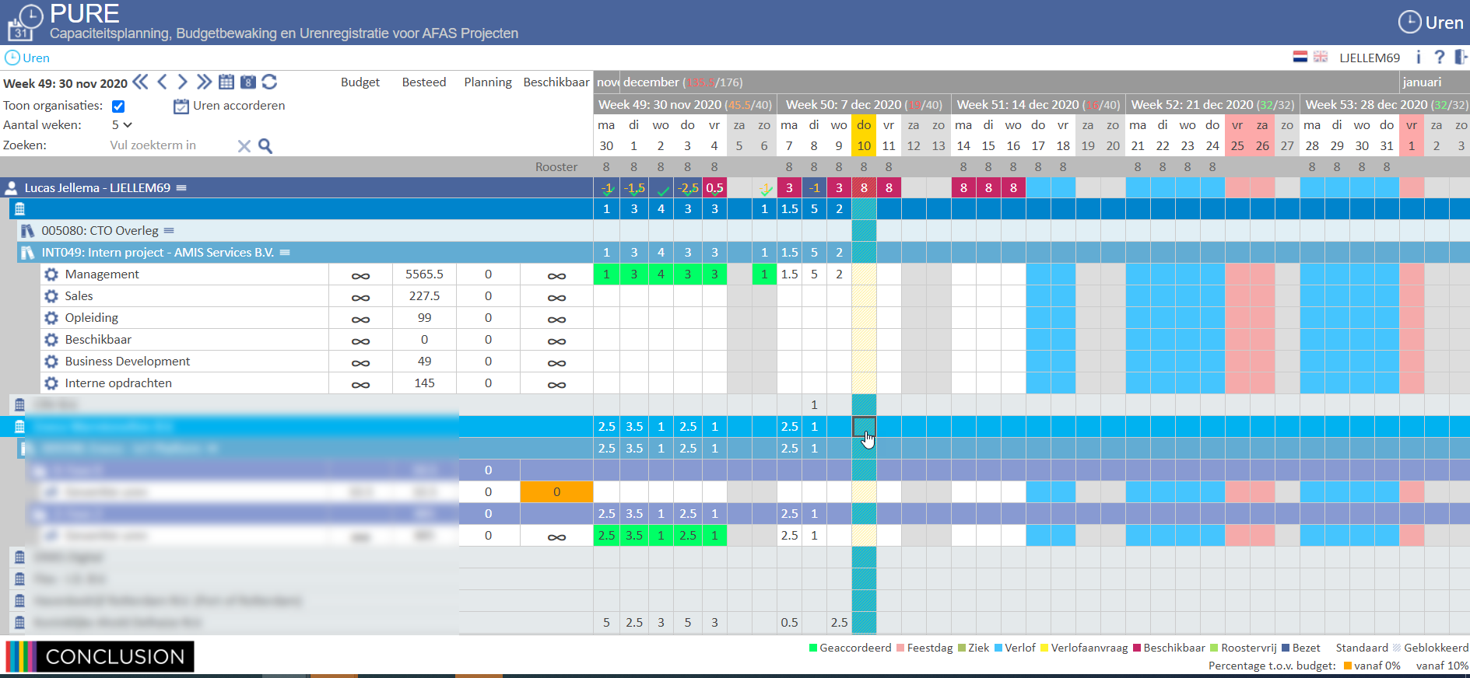
Demo – Timesheet Deeplink Bookmark
Manually
Deeplink Bookmark
Open browser
Navigate to page
Login
<MFA approval on mobile phone>
Confirm popup
Click on navigation button
<new frame opens>
Click on navigation button
<timesheet opens>
Expand Project
<wait>
Expand Project
<wait>
…
Start entering hours
Click on Shortcut
<MFA approval on mobile phone>
<wait>
Start entering hours

Slide 3
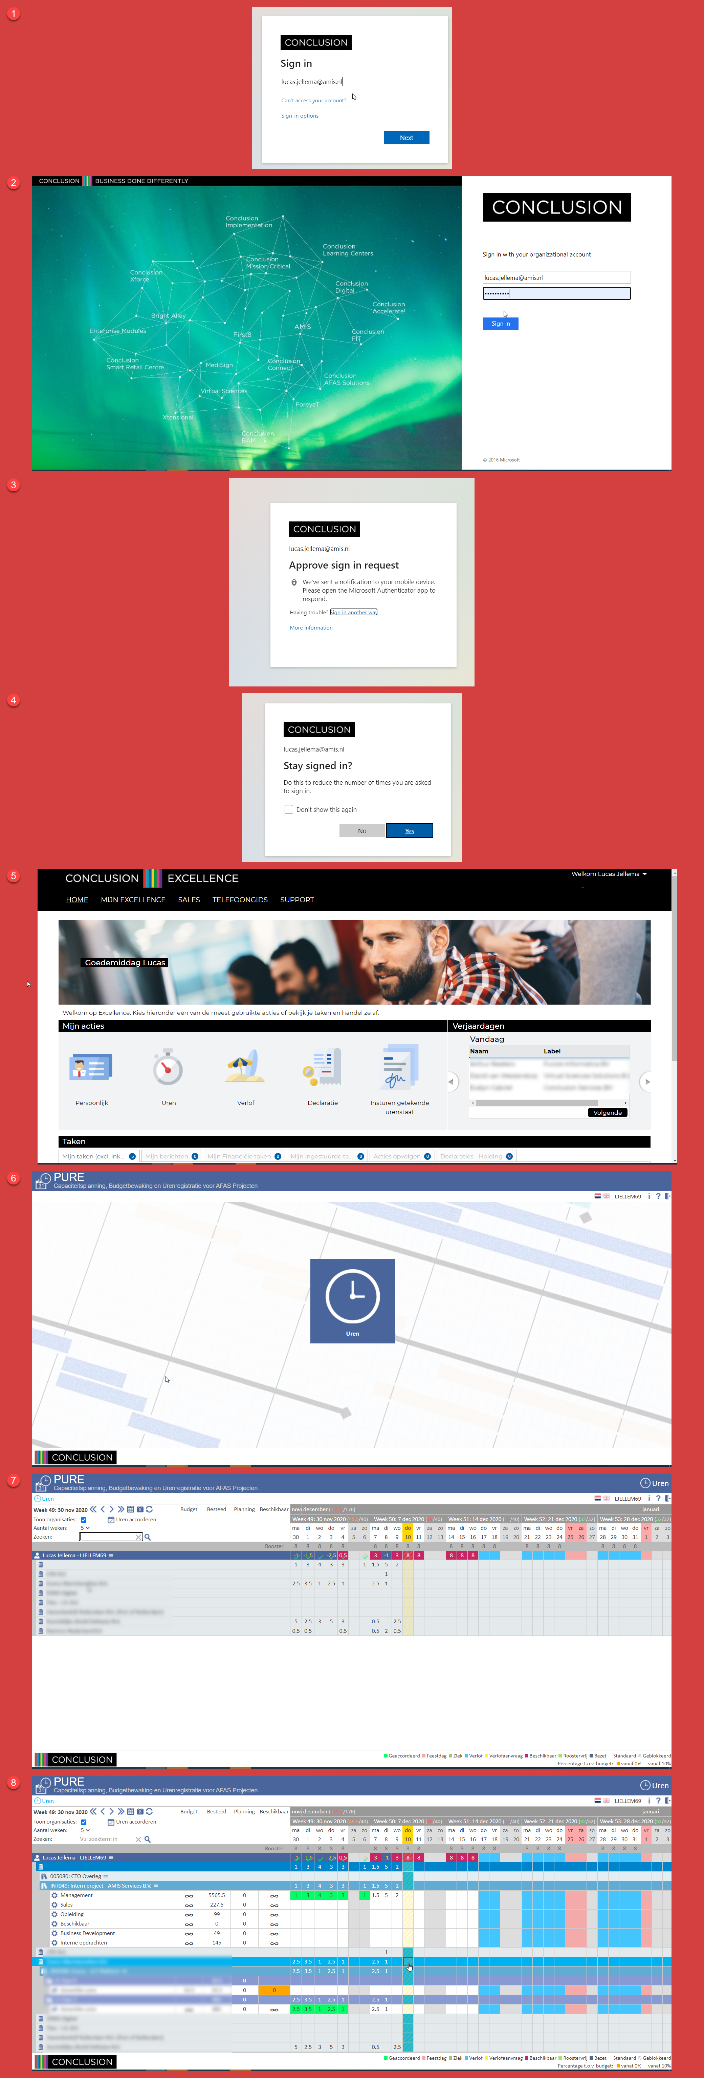


Deep Link Bookmark – Under the Hood

Slide 4

Playwright – a robot-in-a-browser

Slide 5
Playwright – a robot-in-a-browser
HTTP Requests to fetch HTML, CSS, JS, images, JSON, SVG, XML, SSE, files, …
My Custom Application
Web Application
HTTP Requests to post data, upload files, …
DOM, JavaScript context, web workers, local storage, cookies,

Slide 6
Playwright – a robot-in-a-browser
HTTP Requests to fetch HTML, CSS, JS, images, JSON, SVG, XML, SSE, files, …
Read DOM elements, fill in fields, click buttons, trigger events, manipulate/add DOM elements, add and execute JavaScript
My Custom Application
Web Application
HTTP Requests to post data, upload files, …
DOM, JavaScript context, web workers, local storage, cookies,

Slide 7
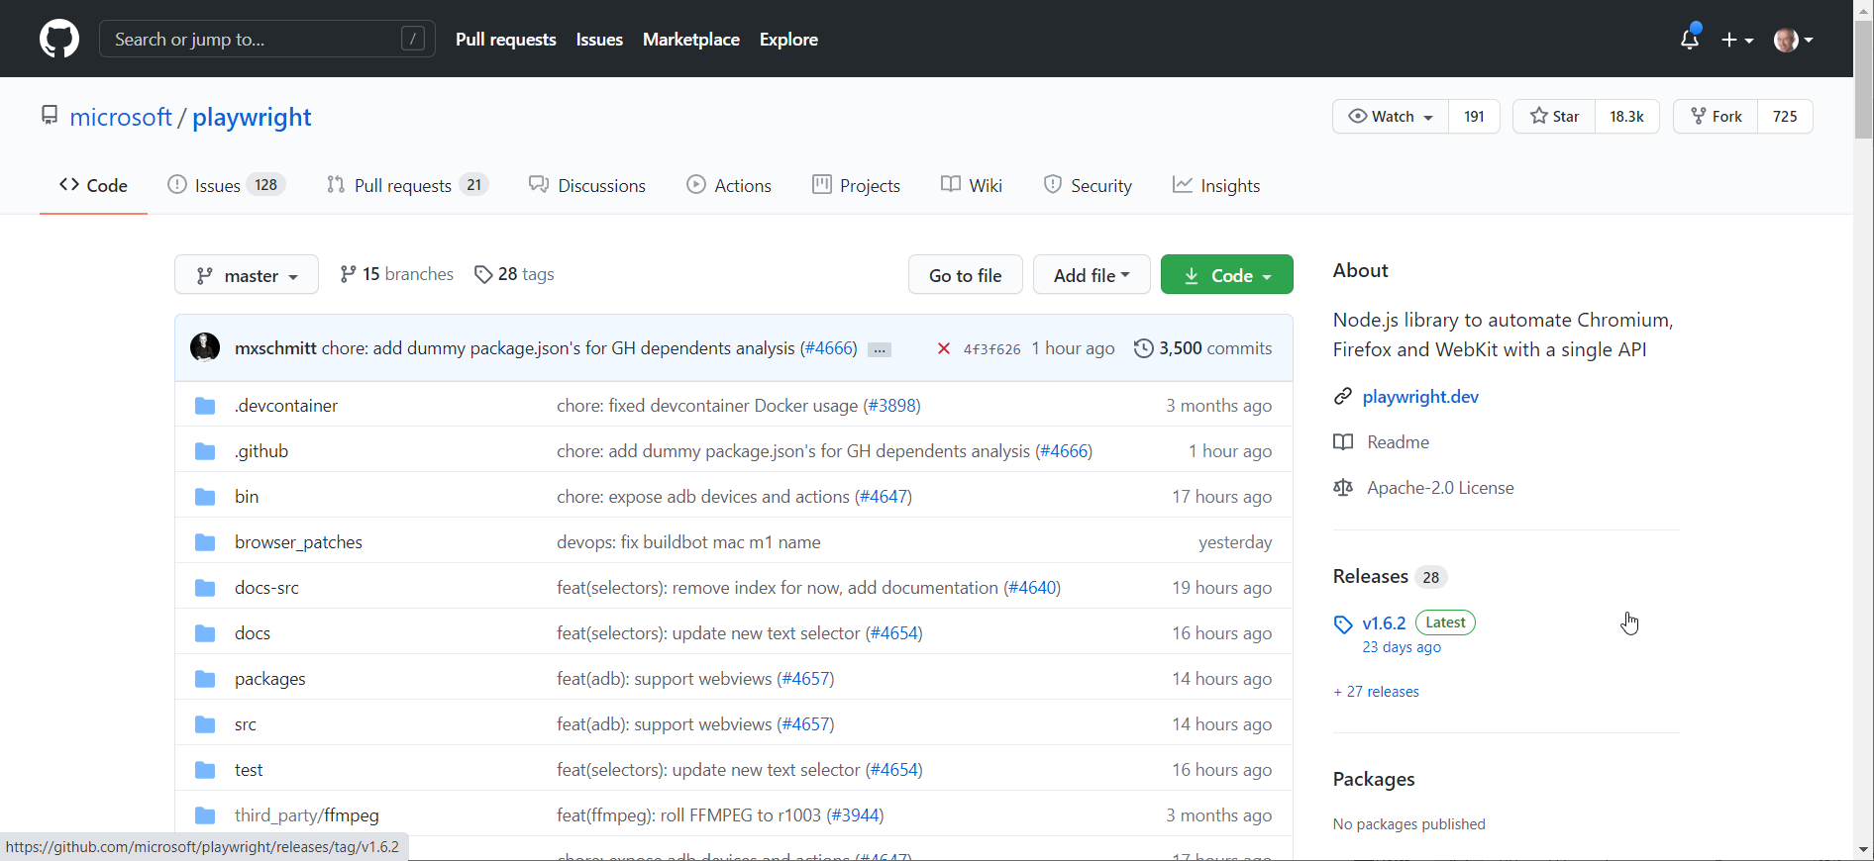
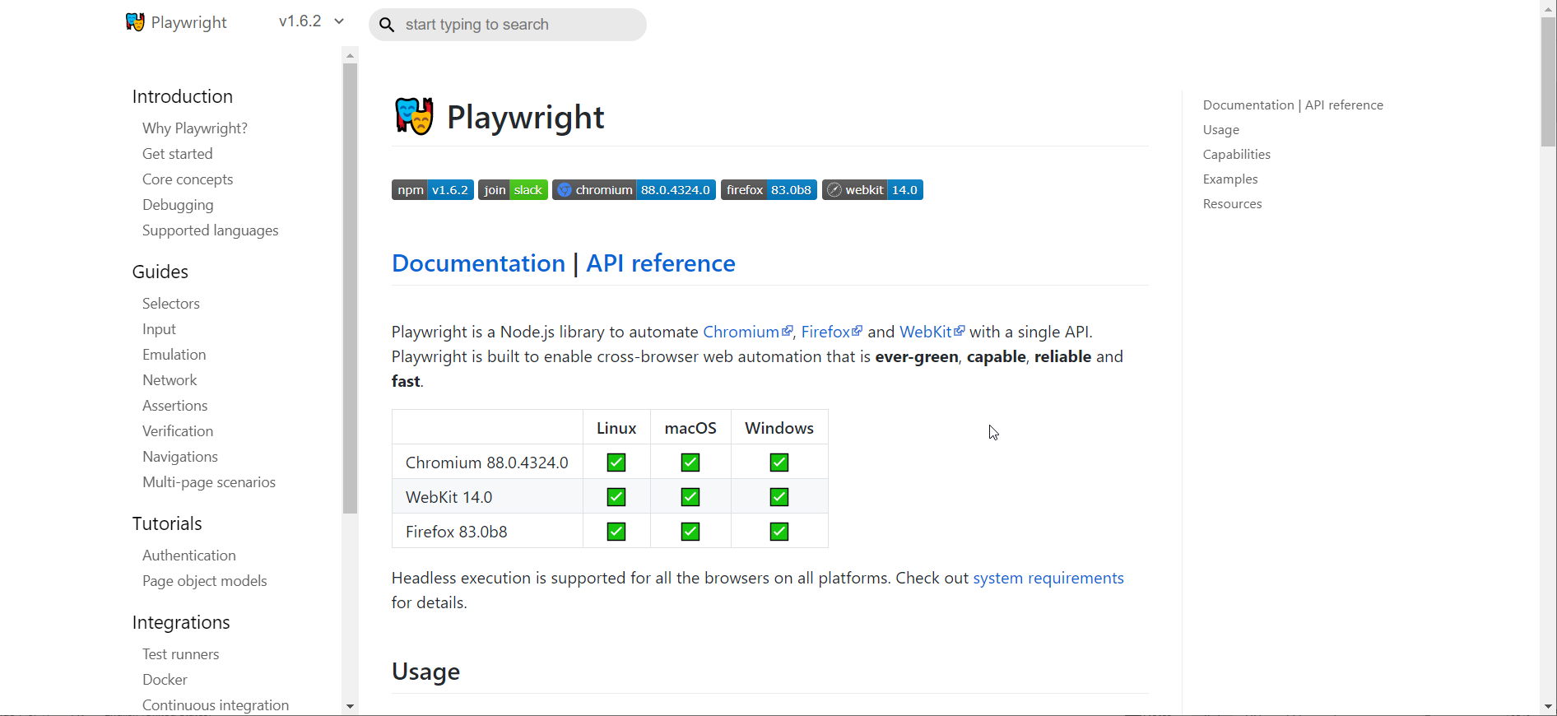
History of Playwright
First release January 2020
By Microsoft - the team that first created Puppeteer (while working at Google)
Open Source – on GitHub
Support for Chromium, Firefox and WebKit
Docker Container to running Playwright scripts: mcr.microsoft.com/playwright:bionic
The Playwright API is available for
JavaScript and TypeScript
Python
C#
Go
Is an alternative to WebDriver
Homepage: playwright.dev

Slide 8
Hello World of Playwright Demos
//navigate to whatsmyuseragent.org and take a screenshot.
const { chromium } = require('playwright’);
(async () => {
// start headless embedded browser
const browser = await chromium.launch({headless: false});
const page = await browser.newPage();
await page.goto('http://whatsmyuseragent.org/');
await page.screenshot({ path: `example.png` });
await browser.close();
})();

Slide 9

Many Opportunities Open Up
Deeplink Bookmarks
UI Test automation
including visual regression (use Resemble.js, pixelmatch, Rembrandt.js)
behavior driven testing
Tactical integration
automation of data retrieval (“Screen Scraping”)
and data entry
Health Checks (monitoring of User Interfaces)
Automated Reporting
Customized Web Application (vanity UI)
UI turned API
RPA – Robotic Process Automation
automated workflow across multiple systems
possibly a collaboration between human & robot

Slide 10

UI as API
Web Application
API

Slide 11
UI as API
Web Application
API

Slide 12
Google Translate UI published as API
Translation API to easily translate a text from source to target language
Web Application
API

Slide 13
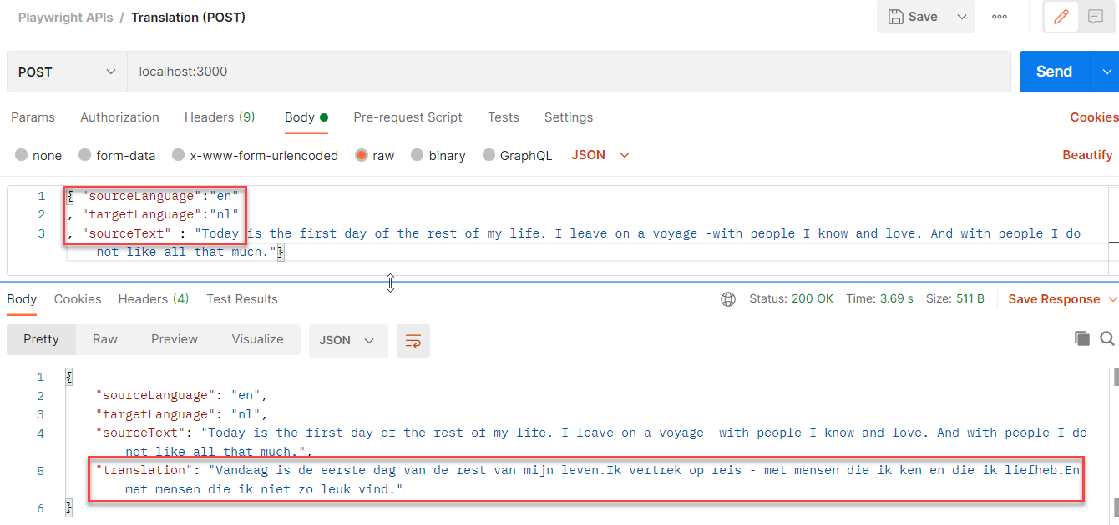
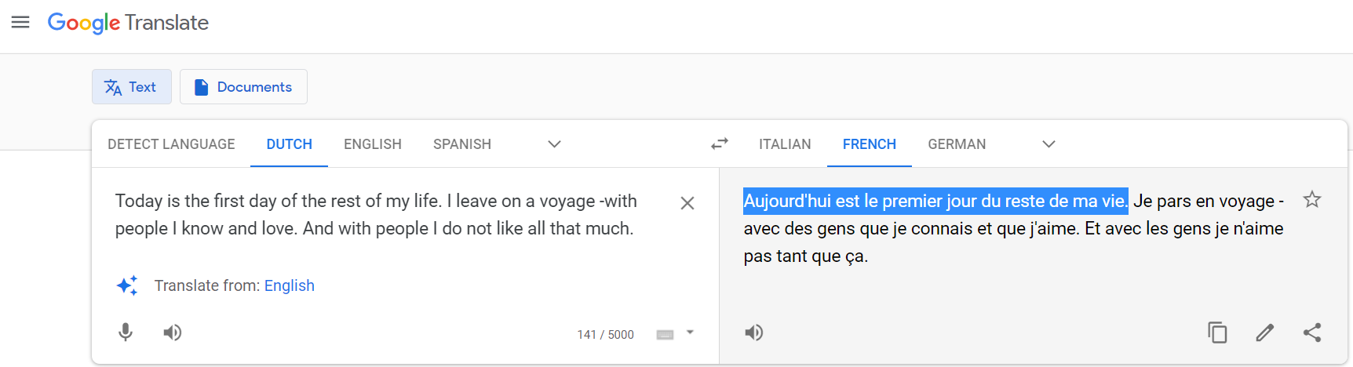
Google Translate UI published as API
Web Application
API

Slide 14
Demo of Translation API (powered by Google Translate)
const translate = async (sourceText, sourceLanguage, targetLanguage) => {
const browser = await chromium.launch({ headless: true })
const context = await browser.newContext()
const page = await context.newPage()
const navigationPromise = page.waitForNavigation()
await page.goto(`https://translate.google.com/?sl=${sourceLanguage}&tl=${targetLanguage}`)
await navigationPromise
await page.waitForSelector('textarea')
}

Slide 15
Demo of Translation API (powered by Google Translate)
const translate = async (sourceText, sourceLanguage, targetLanguage) => {
const browser = await chromium.launch({ headless: true })
const context = await browser.newContext()
const page = await context.newPage()
const navigationPromise = page.waitForNavigation()
await page.goto(`https://translate.google.com/?sl=${sourceLanguage}&tl=${targetLanguage}`)
await navigationPromise
await page.waitForSelector('textarea')
// set text to translate in the source textarea; note: if length of sourceText > 5000, // then we should process the sourceText in multiple (parallel processed) slices
await page.fill('textarea', sourceText);
// give Google Translate a little time to perform the translation
await sleep(800)
// get translations from target area (which consists of one or more spans): '.VIiyi > span > span'
const translatedLines = await page.$$eval(".VIiyi > span > span", (spans) => {
return spans.map(span => span.innerText); });
// concatenate the individual lines to a single string
const translation = translatedLines.reduce((accumulator, line) => accumulator + line)
await browser.close()
return translation
}

Slide 16
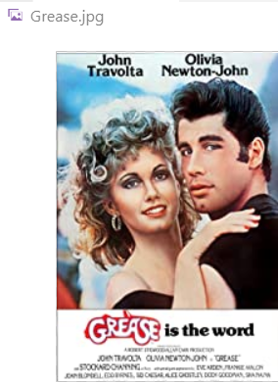
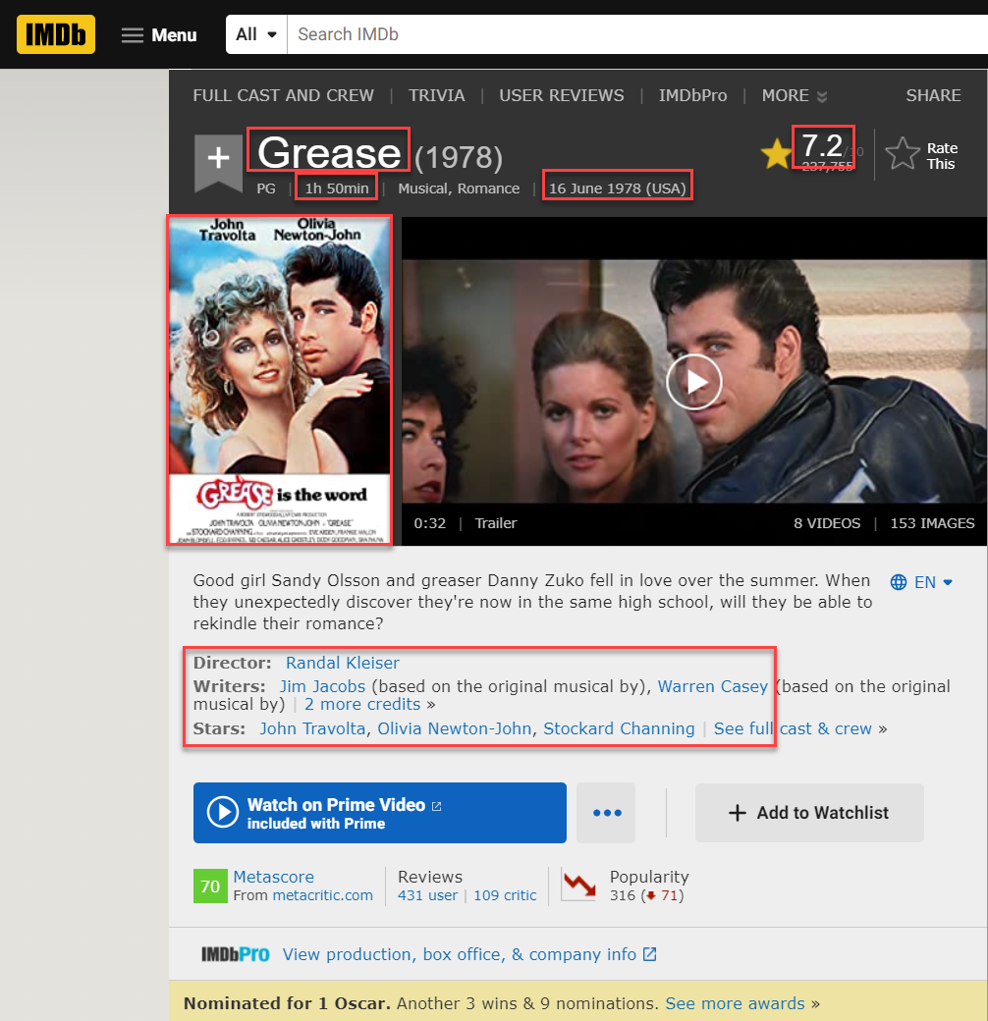
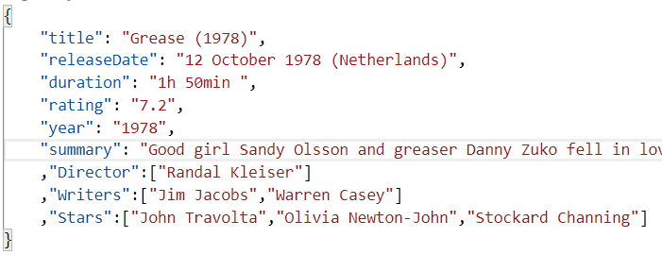
Programmatic IMDb Data Scraping
Web Application
REAL Toolshed | December 2020 | Playwright browser automation

Slide 17
Features
Headless and Headful
Bi-directional JavaScript interaction: from Node to Browser and from Browser to Node context (write to console within the browser or in Node)
Download and Upload Files
Get images (and write to file)
Create Screenshots (.png and PDF)
Record Playwright Session as Video (MP4)
Access to WebPerformance APIs
Social Login (Google, Microsoft Live)
but not 2FA or Captcha
Cookies, Local Storage, Web Workers,
Manipulating network requests (HTTP requests sent from the page)
Headless Recorder (browser plugin and QA Wolf) to record Playwright scripts
Make the browser do anything a user can make the browser do and everything a developer injecting JavaScript into a live session can activate
Notes:
https://dev.to/mxschmitt/using-jest-with-playwright-40lh

Slide 18

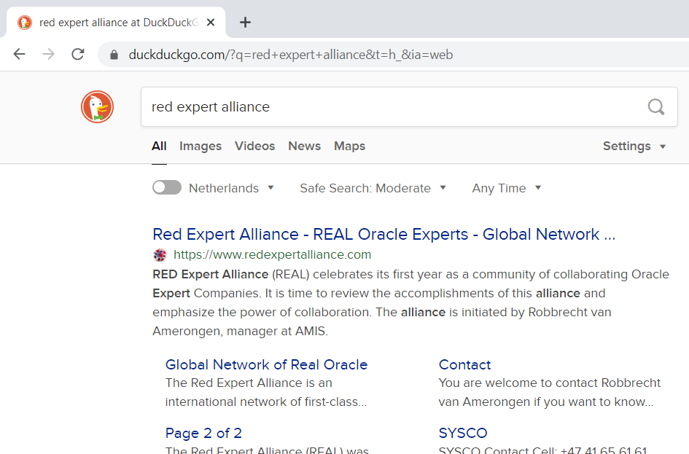
Customised UI

Slide 19
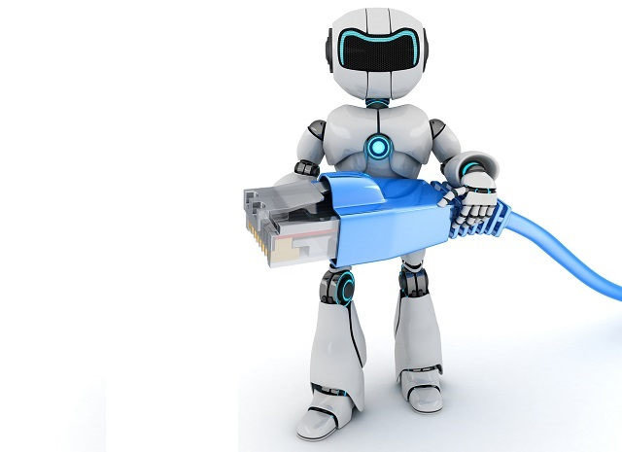
Notes
Integrate with test frameworks
Mocha, Chai, Jest, CodeceptJS, …
Run as Serverless Function
AWS Lambda, Azure Function, Heroku, Oracle Functions, …
Integrate in CI/CD Pipeline

Slide 20
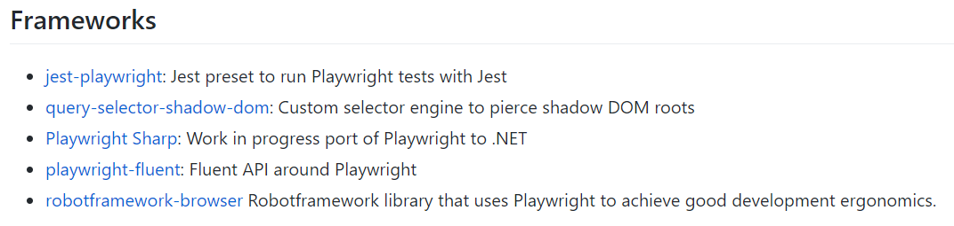
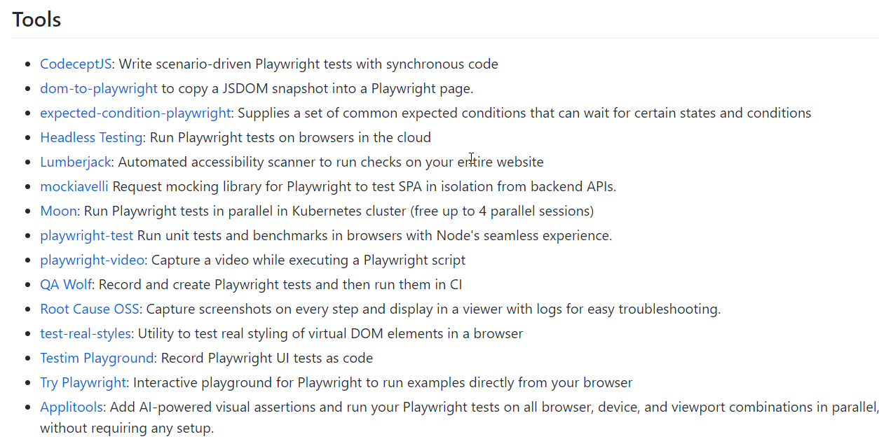
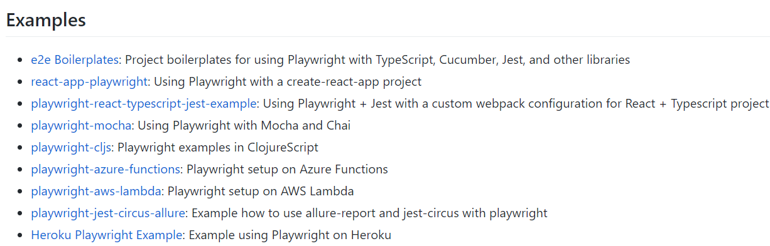
Tools & Ecosystem

Slide 21
The End (or rather: a beginning)
sources: bit.ly/REAL-playwright

